Slide 1
Introduction to Python
Week 2

Slide 2
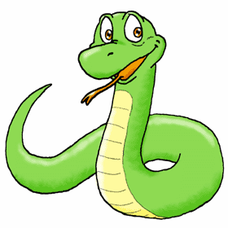
Python
Python is:
A general purpose, high-level programming language
It’s design philosophy emphasizes:
Code readability
Ease of learning
Comes with a large and comprehensive standard library

Slide 3







Python is Widely Used
What can you do with Python?
Web development, scientific and numeric computing, machine learning, robotics, data science, automating boring stuff, etc.

Slide 4
Why Are We Using Python?
Simple
Python is a simple, minimalist language
Easy To Learn
Simple syntax, behavior, etc.
Free & open source
High-Level Language
Portable
Runs on most any platform
Interpreted, not compiled
What does this mean?

Slide 5

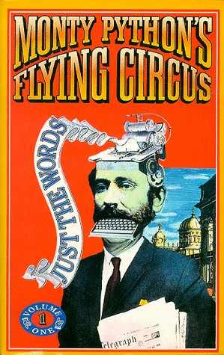
Brief History of Python
Python is a relatively new language!
Python originated in the late 1980s
Developed by Guido Van Rossom (Dutch computer programmer), Python’s "Benevolent dictator for life”
Attempting to create an extensible scripting language
Python got its name from “Monty Python’s Flying Circus
BBC comedy series from the 1970s

Slide 6
MicroPython
MicroPython is a lean and efficient implementation of the Python 3 programming language that includes a small subset of the Python standard library and is optimized to run on microcontrollers and in constrained environments.
Documentation of the Micro:Bit’s MicroPython:
https://microbit-micropython.readthedocs.io/en/latest/#
And the general MicroPython documentation:
https://docs.micropython.org/en/latest/library/index.html

Slide 7
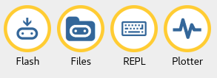
Mu Features
The “Flash” button puts your Python code onto the connected micro:bit
The “Files” button lets you see the files on your Micro:Bit and copy to/from your computer
The “REPL” (stands for “Read, Evaluate, Print, Loop”) allows you to enter Python lines and interactively run them
The “Plotter” button opens Mu’s plotter. If your micro:bit is outputting tuples of numbers via the serial connection, the plotter will display them as a graph.

Slide 8
Variables, Expressions & Statements

Slide 9

Displaying Output with the print Statement
Concept:
You use the print statement to display output in a Python program.

Slide 10
Displaying Output with the print Statement
Strings and String Literals
A string is a sequence of characters that is used as data.
When a string appears in the code of a program, it is called a string literal.
In Python, single-quotes (‘) or double-quotes (“) can be used to enclose string literals.

Slide 11
Displaying Output with the print Statement
Strings and String Literals
If a string literal contains either a single-quote or apostrophe, then enclose the string literal in double-quotes.
If a string literal contains a double-quote, then enclose the string literal in single-quotes.
print ("don't hesitate")
print ('my favorite class is "INFO 697"')

Slide 12
Displaying Output on the M:B
Display
This module controls the 5×5 LED display on the front of your board.
It can be used to display images, animations and even text.
Some useful functions:
microbit.display.scroll(value, delay=150, *, wait=True, loop=False, monospace=False)
microbit.display.show(image)
microbit.display.clear()
Full reference: https://microbit-micropython.readthedocs.io/en/latest/display.html

Slide 13
Function Basics
A function is a named container for a block of code
Typically code you want to easily reuse!
An argument is a way of passing data into a function
Microbit built-in function examples:
microbit.display.show(image)
This function has one required argument - image
microbit.display.clear()
This function has no arguments

Slide 14
Module Basics
Functions contain blocks of code…
Modules are groups of functions
To use modules, we can use either the import or the from keyword
To be able to use all the Micro:Bit functions, we first import the Micro:Bit library:
from microbit import *

Slide 15

Variables
Concept:
A variable is a name that represents a value stored in the computer’s memory.

Slide 16

Variables
Creating Variables with Assignment Statements
Assignment Statement
variable = expression
variable name of the variable
= assignment operator
expression value or piece of code that results in a value
The age variable references the value 25

Slide 17
Variables
Variable Naming Rules
Can not use Python key words
Can not contain spaces
First character must be one of the letters a through z, A through Z, or an underscore character(_)
After the first character use letters a through z, A through Z, digits 0 through 9, or underscore
Uppercase and lowercase characters are distinct

Slide 18
Variable Naming Rules
For readability use one of the below styles for multiword variable name:
Use the underscore character to represent a space, aka “snake_case”
gross_pay
hot_dogs_sold_today
Or use “camelCase” with words uppercased
grossPay
hotDogsSoldToday
Most importantly – stick to the convention used by your peers or the existing codebase!

Slide 19
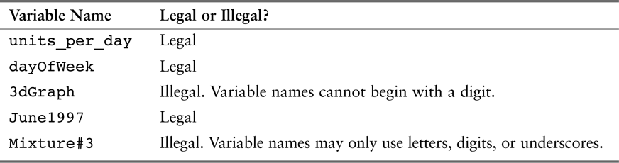
Variables
Variable Naming Rules
Sample variable names

Slide 20
Variables
Displaying Multiple Items with the print Statement
Use a comma to separate the items.
#this program demonstrates a variable
room = 503
print ("I am staying in room number ", room)

Slide 21
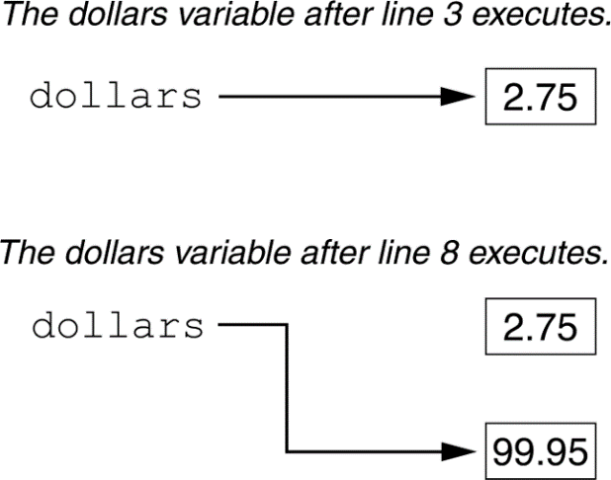
Variables
Variable Reassignment
Variables are called “variables” because they can reference different values while a program is running.
#This program demonstrates variable reassignment
#Assign a value to the dollars variable
dollars = 2.75
print ("I have", dollars, "in my account.")
#Reassign dollars so it represents a different value
dollars = 99.95
print ("I have", dollars, "in my account.")
Variable reassignment

Slide 22
Variables
Numeric Data Types and Literals
A number that is written into a program’s code is called a numeric literal.
A numeric literal that is written as a whole number with no decimal point is considered an int.
For example:
7124, 503, and -9
A numeric literal that is written with a decimal point is considered a float.
For example:
1.5, 3.1415, and 5.0

Slide 23
Variables
Storing Strings with the str Data Type
The str data type is used to store strings in memory.
#Create variables to reference two strings
first_name = "Kate"
last_name = "Smith"
#Display the values referenced by the variables
print (first_name, last_name)

Slide 24
String or Numeric Data Type?
A phone number
An area code
The current temperature
A social security number
A zip code
Tip – if it’s data you would not use in a mathematical calculation it’s probably a string type

Slide 25
Performing Calculations
Concept:
Python has numerous operators that can be used to perform mathematical calculations.

Slide 26
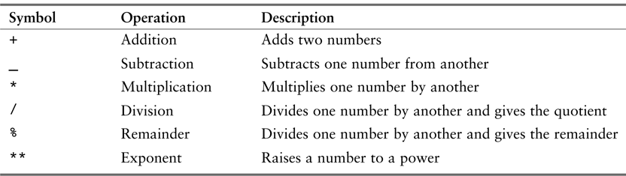
Performing Calculations
A programmer’s tools for performing calculations are math operators, and the following are provided by Python:
Python math operators

Slide 27
Performing Calculations
For Example: A retail business is planning to have a storewide sale where the prices of all items will be 20 percent off. We have been asked to write a program to calculate the sale price of an item after the discount is subtracted.
#This program gets an item's original price and
#calculates its sale price, with a 20% discount
original_price = 11.50
discount = original_price * .2
sale_price = original_price - discount
#Display the sale price
print ("The sale price is", sale_price)

Slide 28
Performing Calculations
Integer Division
When an integer is divided by an integer the result will also be an integer. This behavior is known as integer division.
For Example:
num_add = 17 + 5 # the answer will be 22
num_div_int = 3 / 2 # the answer is 1; 0.5 is the fractional part
# and it is truncated.
num_div_real = 3.0 / 2.0 # the answer is 1.5

Slide 29
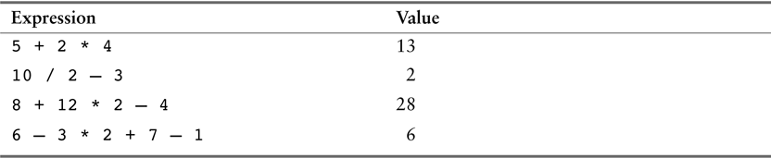
Performing Calculations
Operator Precedence
The precedence of the math operators, from highest to lowest, are:
Operations that are enclosed in parentheses.
Exponentiation **
Multiplication *, division /, and remainder %
Addition + and subtraction -
Some expressions

Slide 30
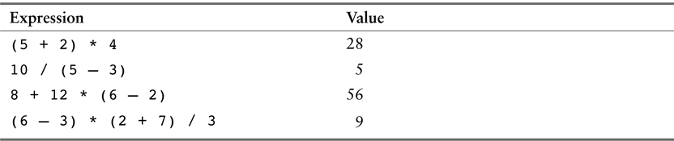
Performing Calculations
Grouping with Parentheses
More expressions and their values

Slide 31
Performing Calculations
The Exponent and Remainder Operators
** is the exponent operator. Its purpose is to raise a number to a power.
For Example:
area = length**2
% is the remainder operator. Its purpose is to perform division and return the remainder.
For Example:
leftover = 17 % 3 #remainder is 2
2-31

Slide 32
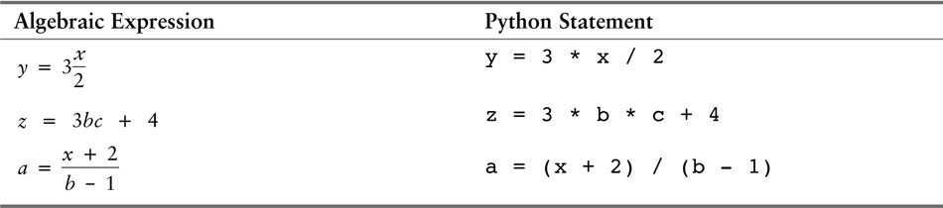
Performing Calculations
Converting Math Formulas to Programming Statements
Algebraic Expression Programming Expression
x = a + b x = (a + b) / 3
3
Algebraic and programming expressions

Slide 33
Performing Calculations
Data Type Conversion
Python follows the following rules when evaluating mathematical expressions:
When an operation is performed on two int values, the result will be an int.
When an operation is performed on two float values, the result will be a float.
When an operation is performed on an int and a float, the int value will be temporarily converted to a float and the result of the operation will be a float.

Slide 34
Performing Calculations
Data Type Conversion
Python built-in float() and int() functions.
For Example:
x = 27.9
y = int(x) # y will be assigned 27
x = -12.9
y = int(x) # y will be assigned -12
y = 7
x = float(y) # x will be assigned 7.0

Slide 35
Performing Calculations
Breaking Long Statements into Multiple Lines
Python allows for a break in a statement into multiple lines by using the line continuation characters, which is a backslash (\).
For Example:
print ‘We sold’, units_sold, \
‘for a total of’, sales_amount
result = var1 * 2 + var2 * 3 + \
var3 * 4 + var4 * 5

Slide 36
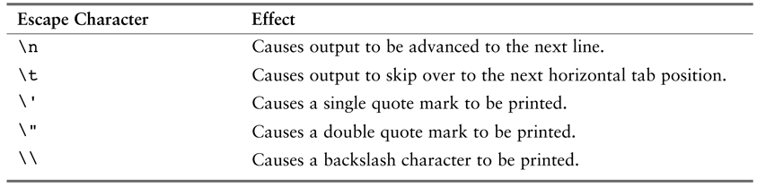
More About Data Output
Escape Characters
A special character that is preceded with a backslash (\), appearing inside a string literal.
For Example:
print ‘One\nTwo\nThree’
Output
One
Two
Three
Some of Python’s escape characters

Slide 37
More About Data Output
Displaying Multiple Items with the + Operator
When the + is used with two strings, it performs string concatenation.
For Example:
print (‘this is’ + ‘one string.’ ) # one string is appended to another
Output:
This is one string
2-37

Slide 38

Comments
Concept:
Comments are notes of explanations that document lines or sections of a program. Comments are part of the program, but the Python interpreter ignores them. They are intended for people who may be reading the source code.

Slide 39
Comments
Two types of comments:
full line comment
#This program calculates net pay
end line comment
print (“John Smith”) #display the name
Python begins a comment with a # character

Slide 40
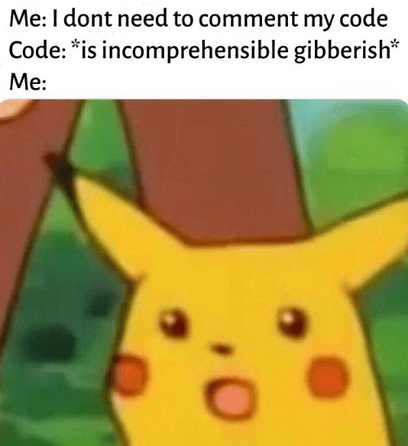
Comments
You should use comments in your code!
Helps other people understand your program
Helps YOU to understand your program

Slide 41
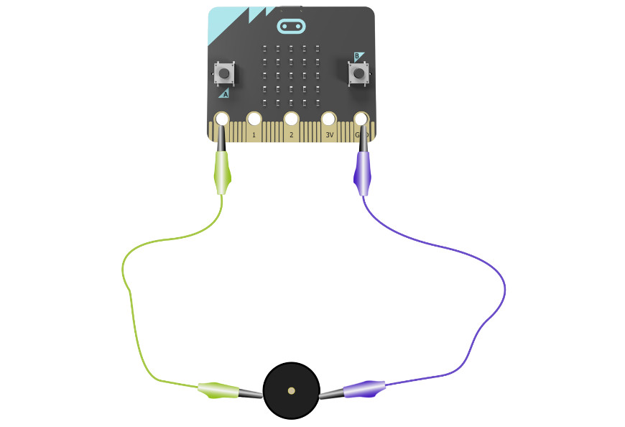
Exercises
Controlling simple circuits and sensors

Slide 42
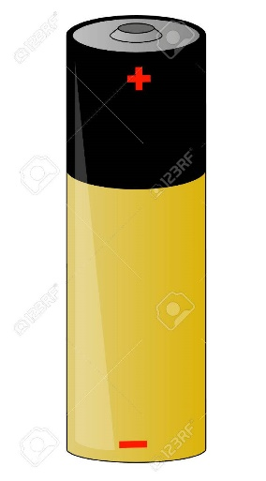
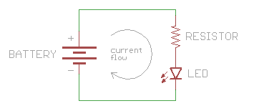
First - What is a Circuit?
Electricity flows through conductive materials
Electricity flows from higher to lower voltages
Every source of electricity has two sides a positive (+) and negative (-)
A circuit is simply a circular path connecting positive to negative, with something(s) in its path that uses the current in some way!
More reading -> https://learn.sparkfun.com/tutorials/what-is-a-circuit/all

Slide 43
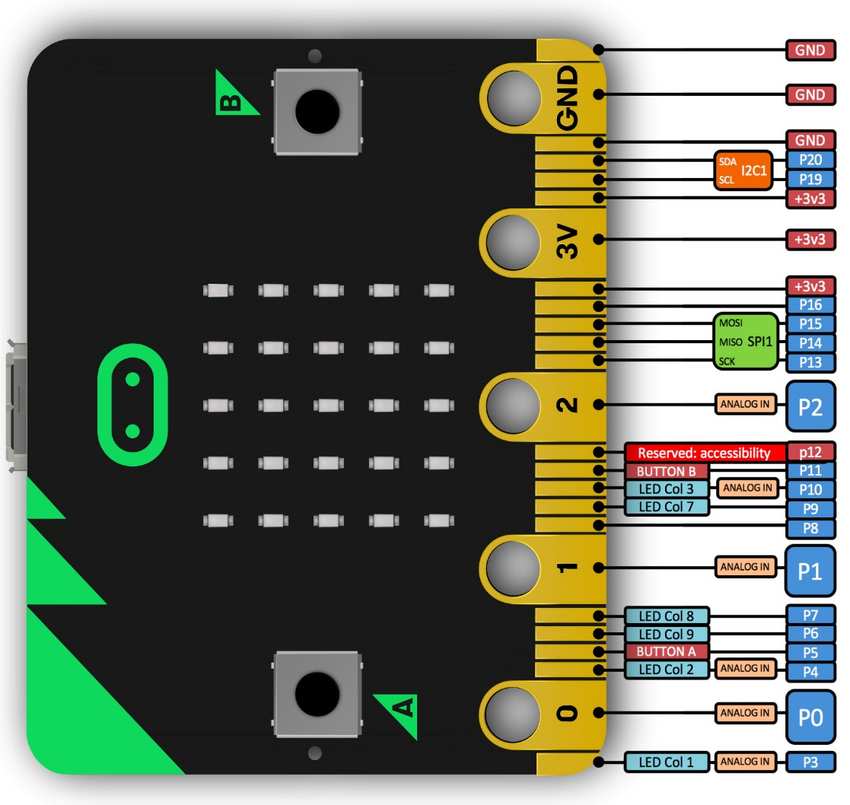
Circuits + The Microbit!
Microcontrollers’ pin(s) serve as dedicated power sources (+), ground (-), and general purpose input/output (GPIO)

Slide 44
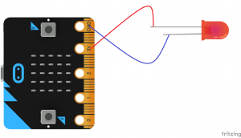
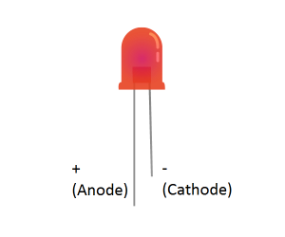
Controlling External LEDs
You will need an LED, a resistor, and TWO alligator clips
An always-on LED (that will eventually burn out!):

Slide 45
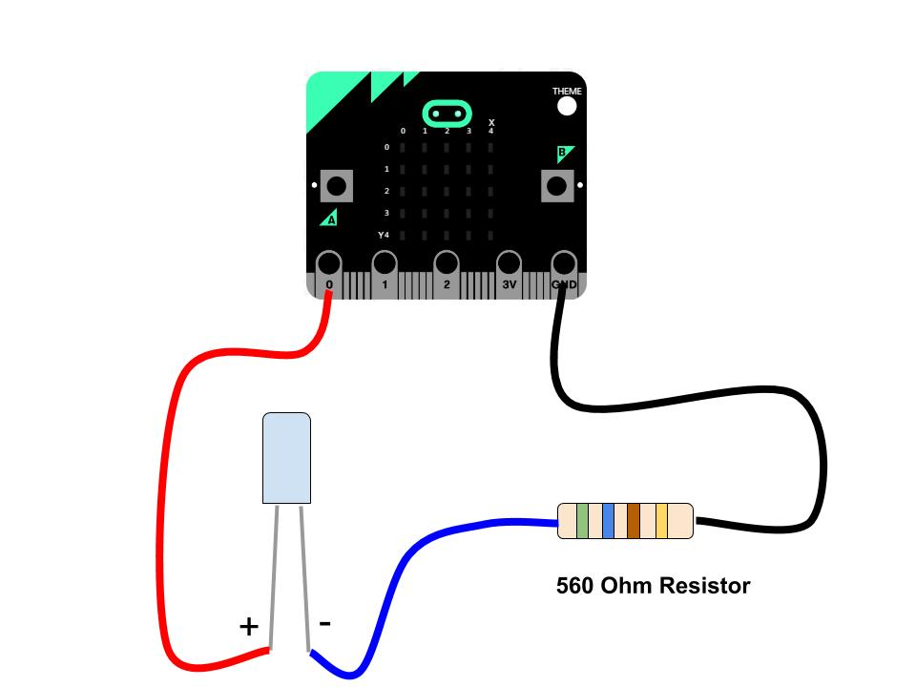
Why do you need a resistor with an LED? To limit the current in the LED to a safe value.
More - http://led.linear1.org/why-do-i-need-a-resistor-with-an-led/
# Turn pin0 on
pin0.write_digital(1)
# Turn pin0 off
pin0.write_digital(0)

Slide 46
Circuits w/ Breakout Board Sensors
Sensors can be purchased already soldered to a small breakout board, this allows you to easily wire it directly to a microcontroller!
The breakout board will have labeled pins:
V = Voltage (or labeled as + or VCC or V1/V2)
G = Ground (or labeled as - )
S = Signal, for sending or receiving signals between the sensor and microcontroller, may have multiple signals!
We must MATCH THESE EXACTLY to the microcontroller pins with the same function

Slide 47
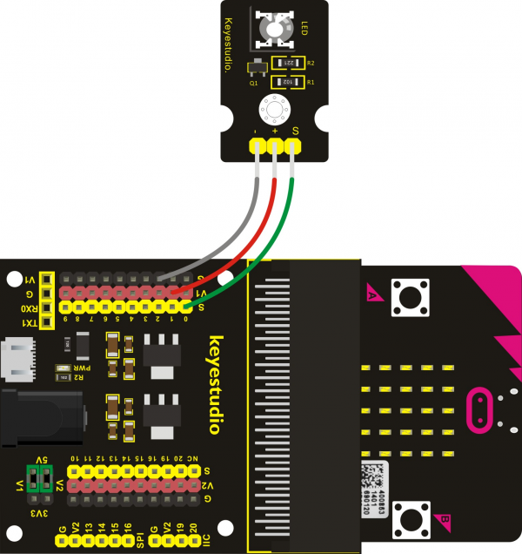
LED breakout board example:
S goes to a numbered signal pin (pin0 in this example)
V/+ goes to a red v1 voltage pin
G goes to the black ground pin

Slide 48
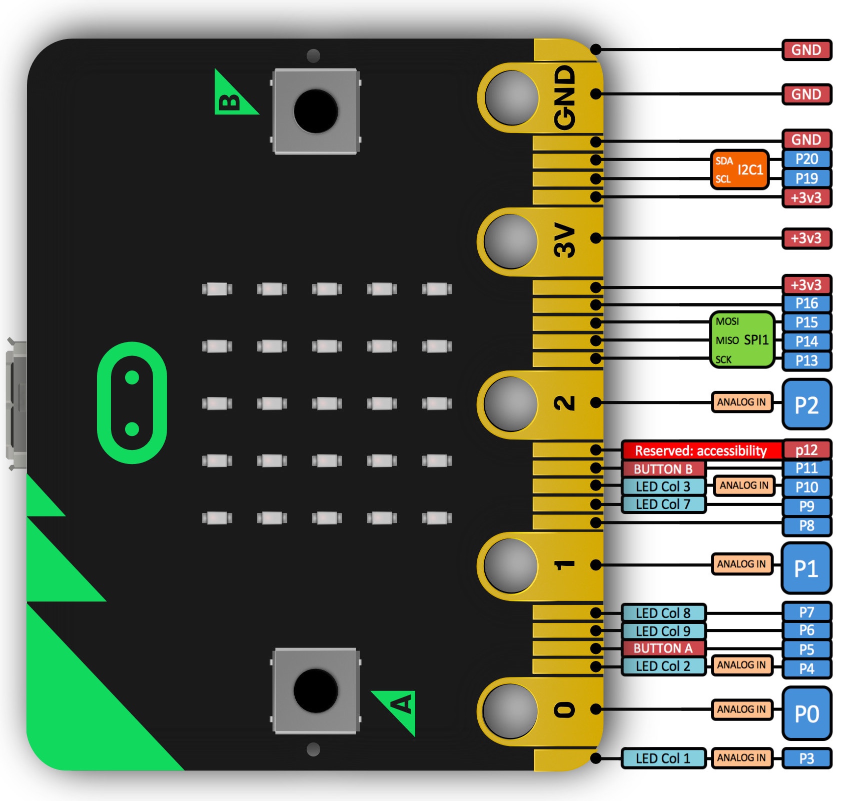
Always ground
# Turn pin0 on
pin0.write_digital(1)
# Turn pin0 off
pin0.write_digital(0)
Always-on power
Pins we can turn on or off
Pins we can turn on or off
Pins we can turn on or off

Slide 49
Python to Flash LED
from microbit import *
# Flash led with signal wire
# attached to pin0
while True:
# Turn pin0 on
pin0.write_digital(1)
sleep(1000)
# Turn pin0 off
pin0.write_digital(0)
sleep(1000)
Turning on pin0 sends the signal to turn ON the LED
Turning off pin0 tells the board to turn OFF the LED
https://lms.pratt.edu/mod/resource/view.php?id=451288

Slide 50
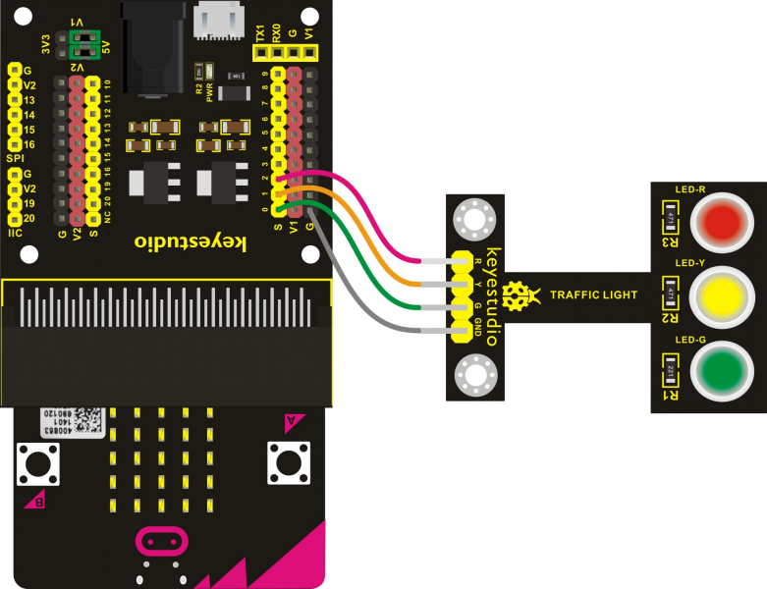
Three-LED Board!
This breakout board has THREE signal lines and a GND line

Slide 51
Three-LED Board Example
from microbit import *
while True:
# Turn pin0 on
pin0.write_digital(1)
sleep(1000)
# Turn pin0 off
pin0.write_digital(0)
# Turn pin1 on
pin1.write_digital(1)
sleep(1000)
# Turn pin1 off
pin1.write_digital(0)
# Turn pin2 on
pin2.write_digital(1)
sleep(1000)
# Turn pin0 off
pin2.write_digital(0)
Turning on/off pin0 sends the signal to turn ON/OFF the green LED
Turning on/off pin1 sends the signal to turn ON/OFF the yellow LED
Turning on/off pin2 sends the signal to turn ON/OFF the red LED
https://lms.pratt.edu/mod/resource/view.php?id=451305

Slide 52
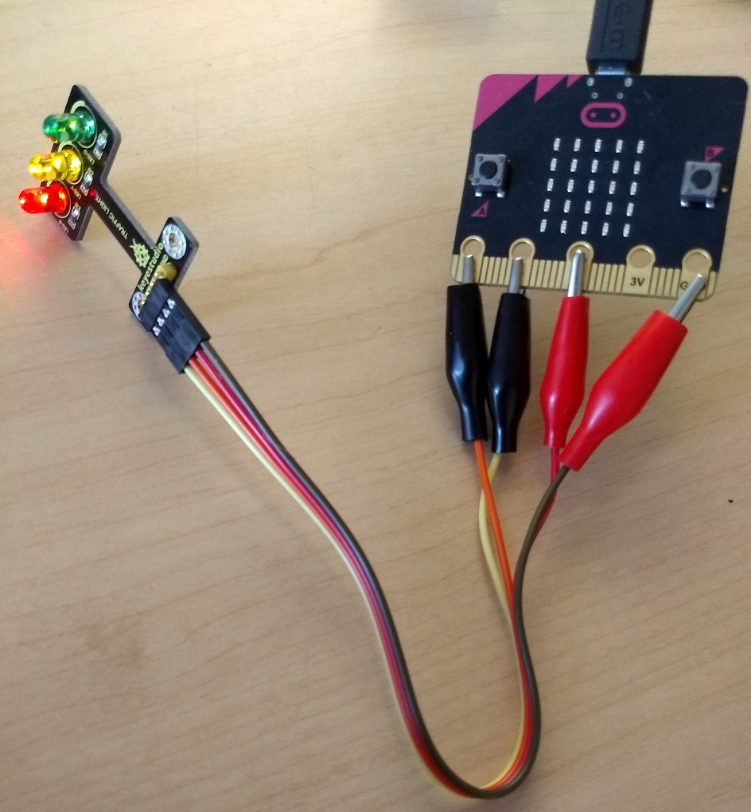
Create a Realistic Stop Light
Make the light green for awhile, then yellow briefly, then red, then repeat!

Slide 53
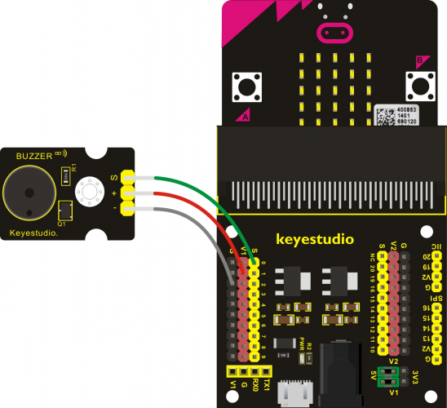
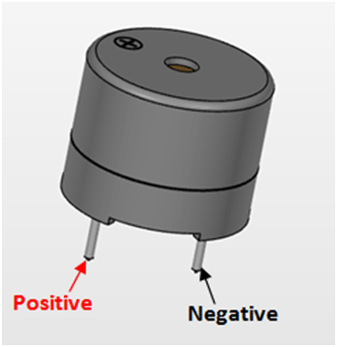
Play a Buzzer “Song”
Other songs here -> https://microbit-micropython.readthedocs.io/en/latest/tutorials/music.html
from microbit import *
import music
music.play(music.NYAN)

Slide 54
Crosswalk Exercise
Connect both the BUZZER and the THREE-LIGHT LED to the Microbit
NOTE – the buzzer must be connected to pin0, other pins have reserved uses, good ones for the LEDs are pin1, pin2 and pin8
Make a song play while the light is RED so that visually-impaired users can know it is safe to cross.
Optionally, make a warning noise sound when the light turns YELLOW
One possible solution, if you get stuck! https://lms.pratt.edu/mod/resource/view.php?id=451326

Slide 55
Plotter + Accelerometer
1) Flash the below code to your Micro:Bit, 2) then press the REPL and Plotter buttons, 3) then try moving your Micro:Bit around to see the accelerometer values generated:
You can also see what current gesture the Micro:Bit thinks is taking place with:
gesture = accelerometer.current_gesture()
Can you tell what accelerometer values generate the different gesture states?
from microbit import *
while True:
sleep(20) print(accelerometer.get_values())

